Slide 1

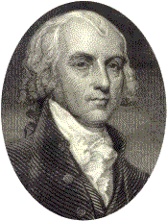
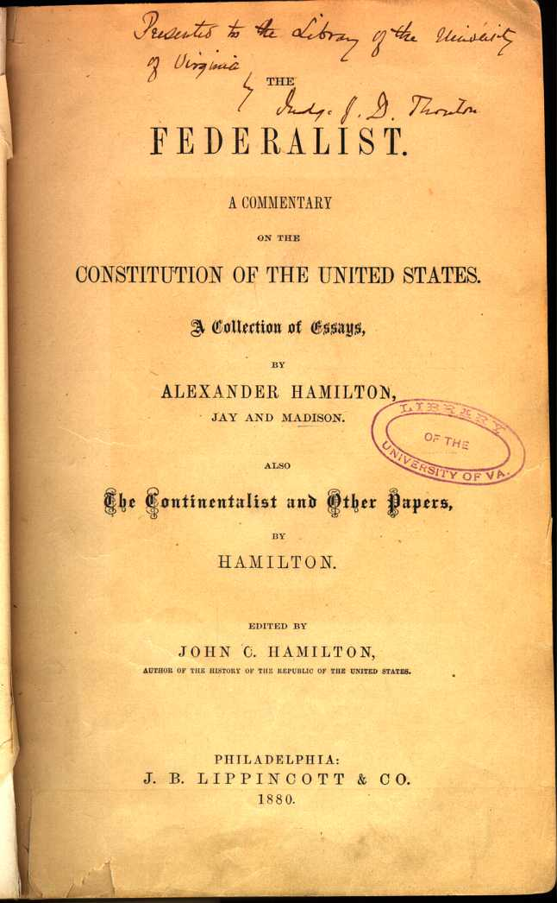
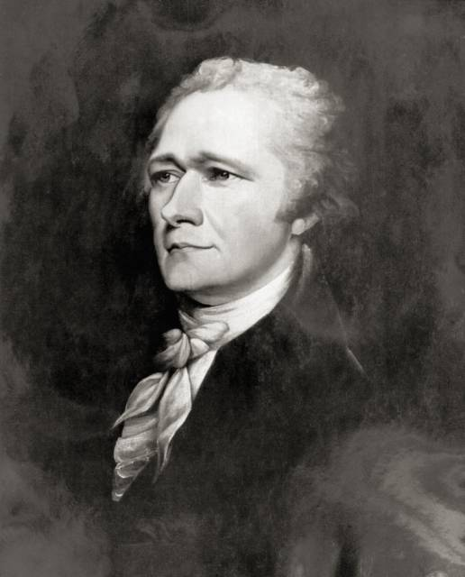
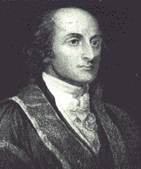
If Men Were Angels: Teaching the Constitution With the Federalist Papers
Presenters: Damon Huss and Pam Jenning

Slide 2
Poll Question #1
What is the main method you use to teach about the framing of the U.S. Constitution?
a. I have students research a project about the Constitutional Convention of 1787 and the history of ratification.
b. I have students do a simulation of the Constitutional Convention.
c. I use lecture, discussion, and primary source readings.
d. None of the above. (Use the chat area to note what you do in your classroom.)

Slide 3

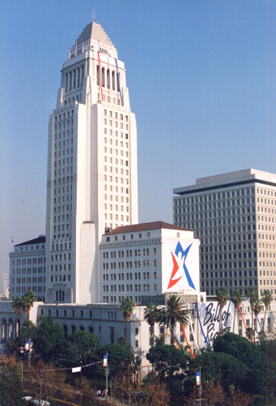
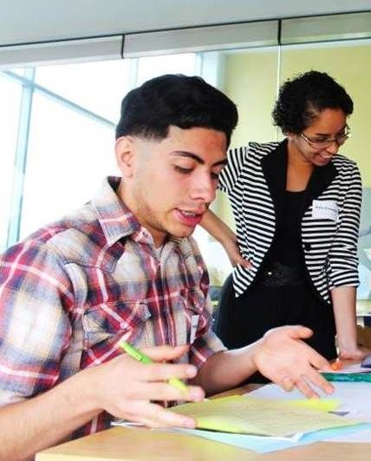
Constitutional Rights Foundation
CRF is a nonprofit, non-partisan, national educational organization. For over 50 years we’ve provided programs, training, and materials supporting teachers and students in the fields of civic and law-related education.
Check us out on the web! www.crf-usa.org

Slide 4
Objectives
Participants will be able to...
Gain background knowledge on the Federalist Papers, including its underlying philosophy and historical significance.
Use Common Core-aligned approaches to teaching about the Federalist Papers and how it helps explain the Constitution.
Implement reading, writing, and discussion activities to make the Federalist Papers relevant and engaging for students.

Slide 5
Lesson Overview
Focus Discussion
Pre-Reading
Small-Group Activity
Whole-Class Discussion
Federalist vs. Anti-Federalist Debate
Optional Writing Activities
Notes:
Click once for each line. Toggle to Lesson Plan.

Slide 6
Poll Question #2
What is the main challenge you face in getting students to do close reading and use textual evidence?
a. The grammar and vocabulary of many primary sources is often too complex.
b. Students do not see the relevance of historical texts to their lives.
c. It takes a lot of class time to examine documents. Students lose patience.
d. None of the above. (Use the chat area to note what main challenge you do face.)

Slide 7


Focus Discussion
Something all over the news.
What is meant by the term “political” or “public” issue?
Something Congress debates about.
Something that affects a lot of people.
Notes:
Click for each response bubble.

Slide 8
Focus Discussion
Global warming.
What are hotly debated issues today?
Gun control.
Health care.
Notes:
Click for each response bubble.

Slide 9
Focus Discussion
School.
How can you find out about these issues?
My parents.
What’s Buzzfeed?
I go on Twitter!
Buzzfeed.
Notes:
Click for each response bubble.

Slide 10
Focus Discussion
Look for facts over opinions.
What do you think is the best way to get reliable information on these issues? Why?
Look for footnotes.
Look for pros and cons.
Notes:
Click for each response bubble.

Slide 11
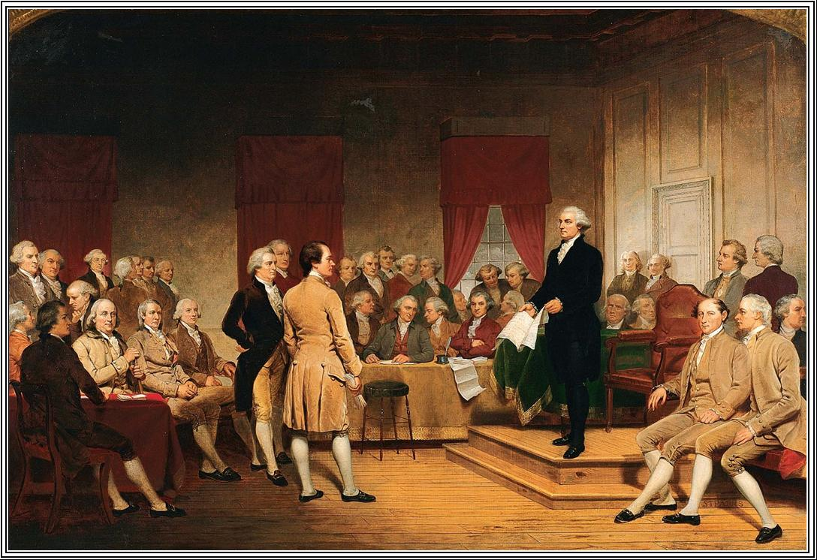
Pre-Reading
Let’s get this party started!
What do hotly contested debates today have to do with the framing of the Constitution?
Notes:
Link the focus activity to the Federalist Papers by explaining that even our Constitution was once an object of intense political debate. Give students the background paragraph, or rephrase in your own voice.
Tell students to look for:
• Why historians and other people today think the Federalist Papers is so important.
• Two key ideas about our Constitution and government that the Federalist Papers explains.
Click once for word bubble.

Slide 12


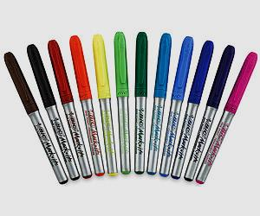
Small-Group Activity
Option A | Option B
Students write a detailed answer to one of the questions on Handout A. | Students make a poster that incorporates key ideas to answer one of the questions on Handout A.
one supporting quote | one supporting quote and visual symbol
Students should be prepared to present their ideas. | Students should be prepared to present their poster.
Notes:
This activity is a significant preparatory step designed to fully engage students in the background reading on the Federalist Papers. Preparation for a more productive, dynamic large-group discussion.
OPTION A
1. Separate students into small groups and assign one question to each group from the questions listed and numbered under For Discussion and Writing on Handout A.
2. Ask students to write a detailed answer to the question by closely examining the text and using at least one direct quote to support.
3. Students should be prepared to present their ideas during the class discussion that follows this activity.
OPTION B
1. Separate students into small groups and assign one question to each group from the questions listed and numbered under For Discussion and Writing on Handout A.
2. Ask students to make a poster that incorporates key ideas from the text and uses one supporting quote. They should also create a visual symbol that illustrates the significance of their information.
3. Students should be prepared to present their poster to the class during the discussion that follows this activity.

Slide 13


“Law of the Land”
A New Plan For Government
ARTICLES OF CONFEDERATION
When: Revolutionary War
Why: Fear of strong government that would deny freedom
Result: (by 1783) Little power, trade difficulties, debt
CONSTITUTION
When: 1787 Philadelphia Convention
Why: desire for strong new national government
Result: 13 delegates sign on September 17, 1787 for approval by 9 of 13 states

Slide 14
Whole-Class Discussion
1
10
2
Presentation
Discussion
9
3
Small Groups
8
4
7
5
6
Notes:
Click to bring up Presentation and Discussion. Click one more time to bring up small groups.

Slide 15
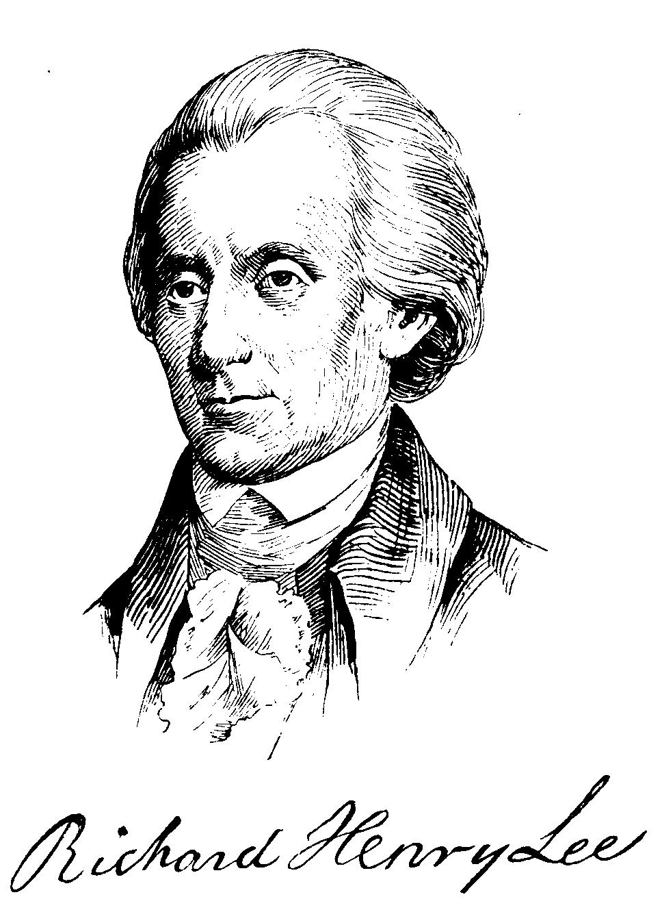
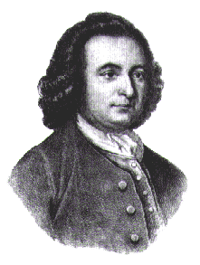
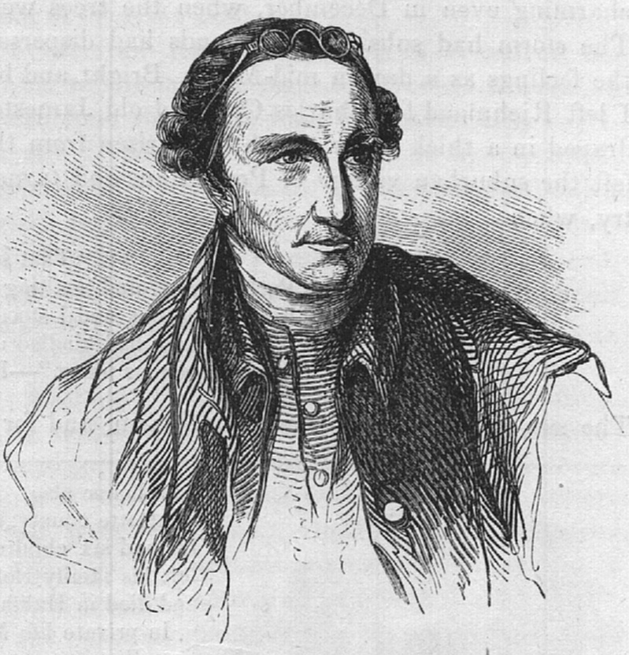
Federalist vs. Anti-Federalist Debate
Yea!
Nay!
Notes:
Click once for Yea and Nay.

Slide 16
Federalist Groups
Anti-Federalist Groups
Madison
Henry
Step One:
Preparation
Jay
Lee
Hamilton
Mason

Slide 17
Federalist vs. Anti-Federalist Debate
Question: Do you think the United States should have a strong central government? Why or why not?
Panel #1
Step Two:
Organize Debate Around Questions
Hamilton
Lee
Mason
Madison
Jay
Henry
Notes:
Click to bring up question. Click again once to let arrows and circles appear and panel graphic.

Slide 18
Federalist vs. Anti-Federalist Debate
Question: Do you think the Constitution should have a bill of rights? Why or why not?
Panel #2
Step Two:
Organize Debate Around Questions
Hamilton
Lee
Mason
Madison
Jay
Henry

Slide 19
Federalist vs. Anti-Federalist Debate
Question: Do you favor or oppose the Constitution? Why?
Panel #3
Step Two:
Organize Debate Around Questions
Hamilton
Lee
Mason
Madison
Jay
Henry

Slide 20
Another Option
Question: Do you favor or oppose the Constitution? Why?
Panel
Step Two:
Organize Debate Around Questions
Questioners
Questioners
Questioners
Questioners
Questioners
Questioners

Slide 21
Alternate Set-Up
Federalist Groups
Anti-Federalist Groups
Madison
A,B
Henry
A,B
Step One:
Preparation
Jay
A,B
Lee
A,B
Two Simultaneous Debates:
A,B
Hamilton
A,B
Mason
A,B
Notes:
Students can be moderators.

Slide 22
Debriefing the Debate
What was the best argument you heard someone make?
Two Components
Debriefing the role play itself, and
2) Debriefing the content, which would include material from their prior reading and discussion.
Based on the arguments you heard today, would you have favored or opposed the Constitution? Why?
What were the arguments over putting a bill of rights in the Constitution?
How did a bill of rights get added to the Constitution?
Notes:
Click to bring up two role-play debriefing questions. Click again to bring up two content debriefing questions.

Slide 23

Optional Writing Activities
Quick-Write
Expository Essay
Extended Writing Activity

Slide 24

UPCOMING FREE WEBINARS
Register:
http://www.crf-usa.org/pd
The Common Core Does Not Have to Be a Great Wall: Fun Ways to Teach About China.
October 15, 2015 from 3:30 – 4:30 (PT)
Civic Engagement + Writing = Uncommonly Good Idea!
October 20, 2015 from 3:30 – 4:30 (PT)

Slide 25
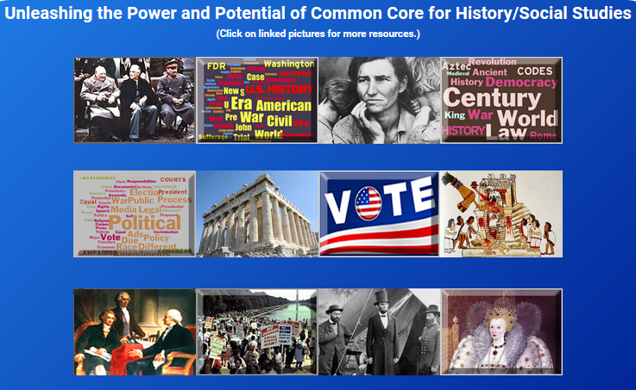
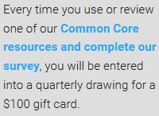
Review Our Resources!
[Add URL for the Resources Page Here.]
crf-usa.org/common-core/blog

Slide 26
THANK YOU!
Damon Huss
damon@crf-usa.org
Special thanks to Laura Wesley at CRF for being the tech-savvy party to this webinar!

