Slide 1
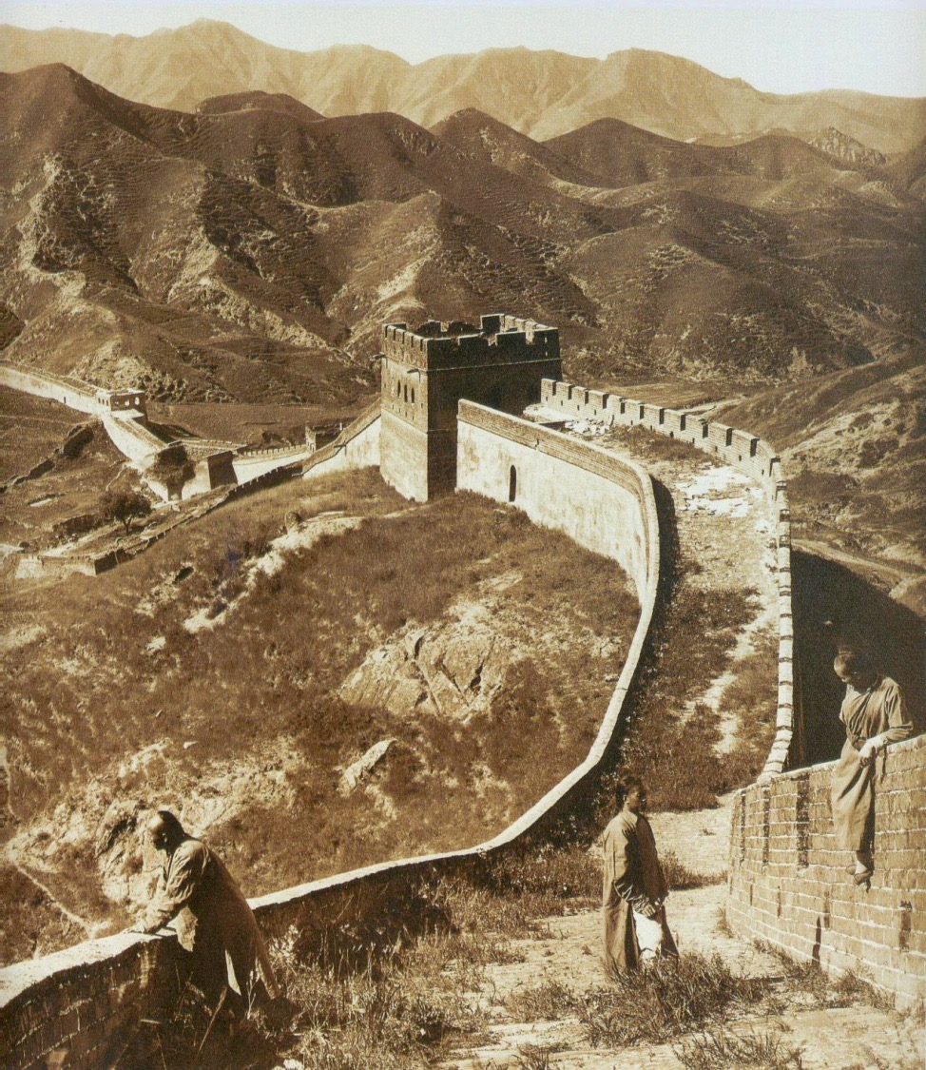
The Common Core Does Not Have to Be a Great Wall:
www.crf-usa.org
Fun Ways to Teach about China

Slide 2
Presenters
Keith Mataya
Keri Doggett
Constitutional Rights Foundation

Slide 3
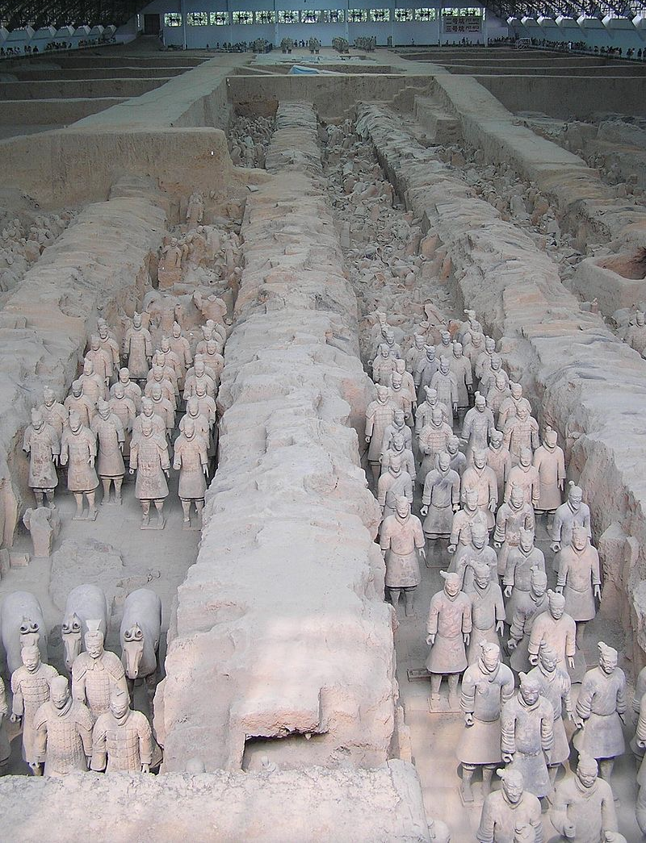
Trivia Question:
What percentage of the famous Terracotta army has been uncovered?
"Terracotta warriors at the pit1 in Xian Wikimedia Commons -

Slide 4
Focus Question:
What’s the most challenging part of teaching Chinese history?

Slide 5
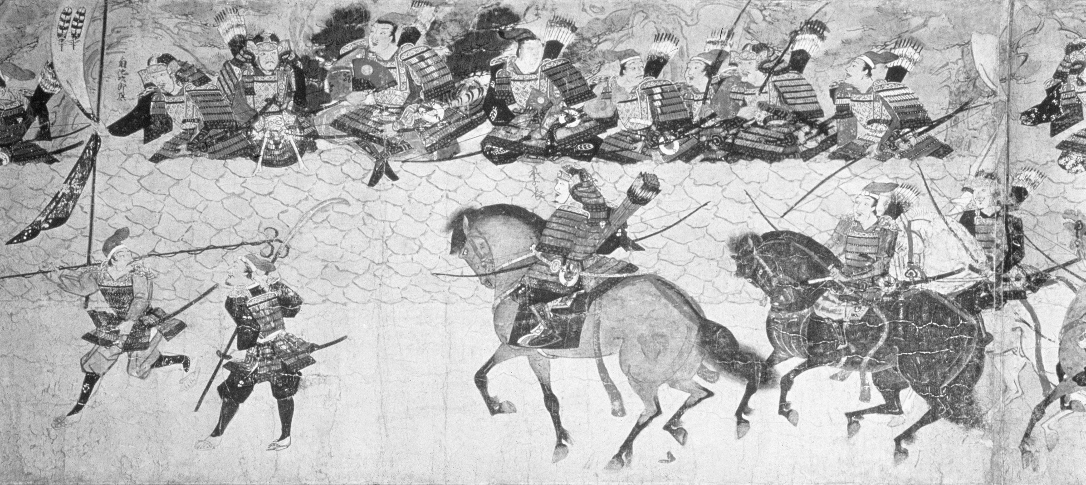
4 Lessons for Teaching China
Lesson 1: Ancient China
Lesson 2: Confucianism and Daoism
Lesson 3: The Law of Shi Huangdi
Lesson 4: The Silk Road

Slide 7
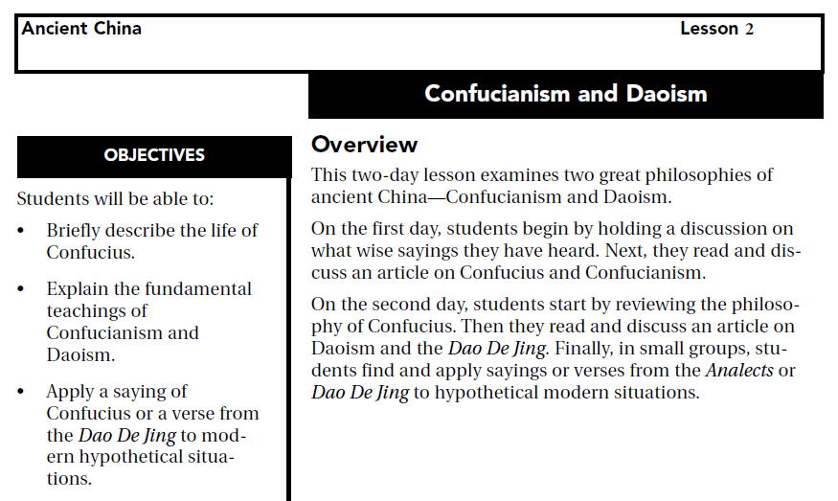

Slide 10
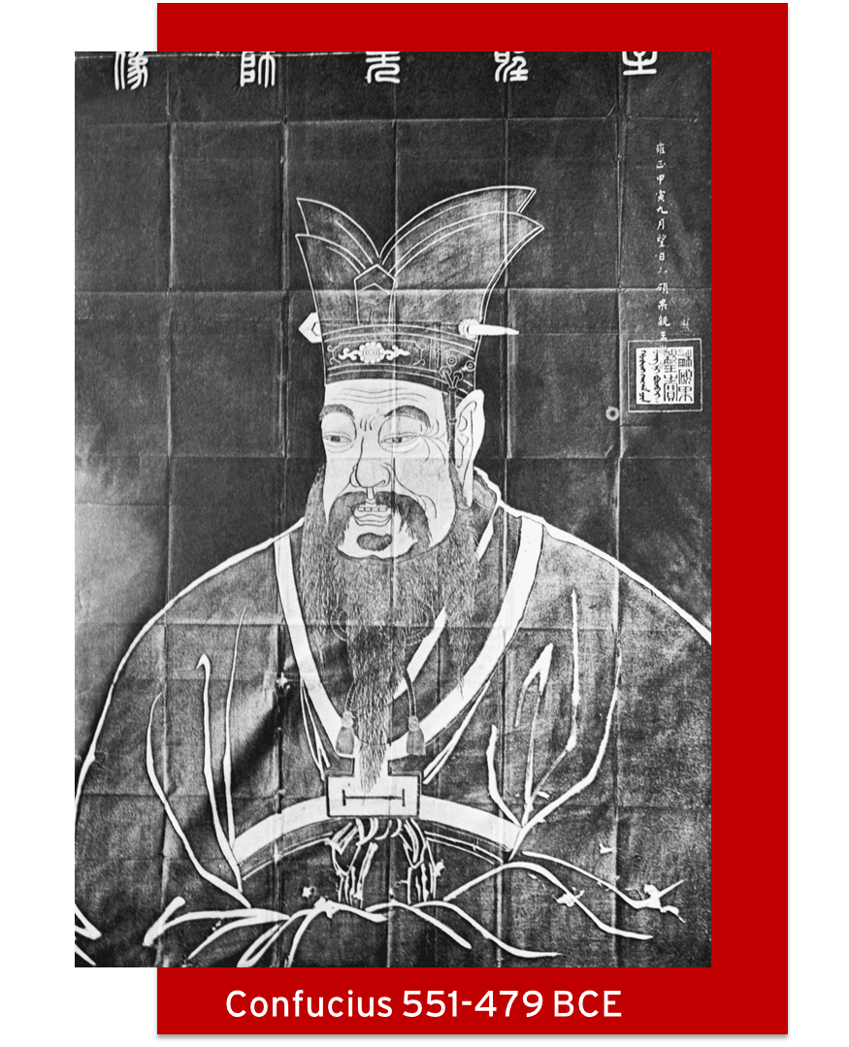
Confucianism and Daoism
Confucius 551-479 BCE

Slide 11
Confucius
What was life like in China at the time of Confucius?
Central authority in China had fallen apart and fighting among nobles made life disorderly and dangerous.
Many people came up with different ideas for putting society back together.
What do we know about the life of Confucius?
He was born into a poor family.
He decided by the age of 15 to spend his life learning math, poetry, history, archery, writing, and other subjects.
He quickly became a famous teacher and taught anyone who came to him, no matter how rich or poor.

Slide 12
Confucianism
What are the main ideas that Confucius believed in?
Being good (ren) is what makes us human and being good makes life worth living.
One of the right things for us to do is yi, doing one’s duties.
Confucius saw everyone as having a duty to everyone else (parent and children, teacher and student, ruler and subjects, etc…)
“The sage (wise person) cares about virtue (de). The inferior person cares about things.”
Ren, yi, and de are expressed through li, or ritual. For Confucius, even our actions of everyday life, like regularly saying “please” or “thank you,” are rituals. Performing rituals correctly help make society run smoothly.

Slide 13
Daoism
What are the main ideas of Daoism?
Dao means “way.” Daoism is about seeking “the way.”
A wise person, someone who seeks the dao, succeeds by not competing or striving for anything.
Wu-wei, which means not doing something for another purpose, is very important. A wise person accomplishes much by not being distracted by such things as fame, money, or winning.
Rulers should be fair and gentle and not pass too many laws.
How is Daoism different from Confucianism? How is it similar?
Difference: Confucianism is more practical, Daoism is more mysterious, less clear.
Difference: A society that practices the basic ideas of Confucianism (de, ren, yi, and li) is already falling apart.
Similarity: Disorder is bad.
Similarity: Rulers should be just.
Similarity: Fame and money are less important than wisdom.

Slide 14
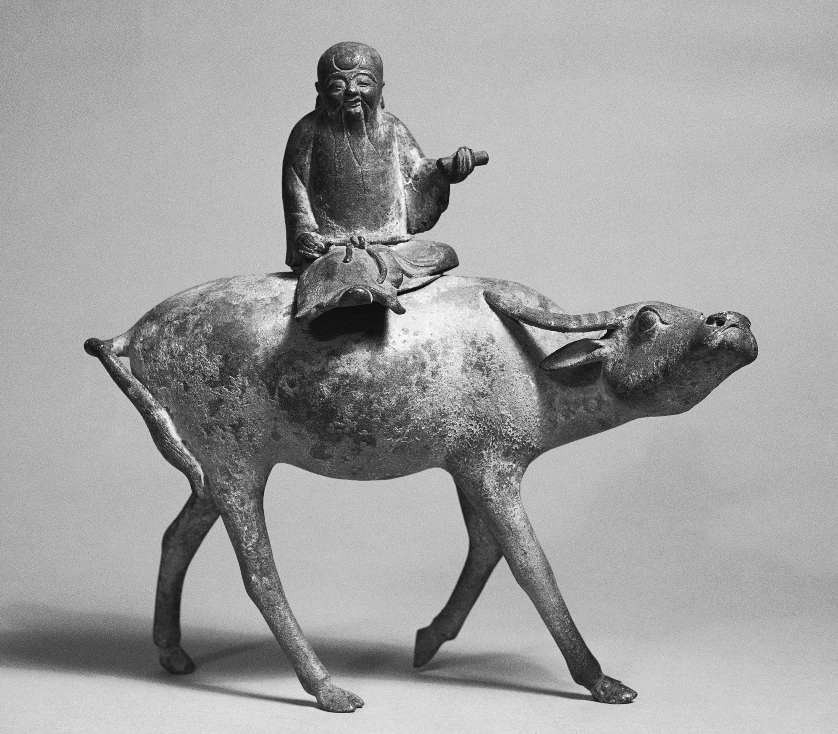
Activity: 4 Scenarios
We will be looking at 4 scenarios.
Decide which saying/verse from the Analects or Dao De Jing best fits the situation.

Slide 15
Scenario One
Chris, a friend of yours, needs help with math homework. You try and explain how to do the problems, but Chris says, “Stop. Just tell me the answers.”
What would the saying we chose recommend doing in this situation?

Slide 16
Scenario Two
You have a huge project due for school in a month. You have to write a paper and give an oral report. You feel it is just too much work and you think you will never get it done.
What would the saying we chose recommend doing in this situation?

Slide 17
Scenario Three
You are the captain of a basketball team. Jamie, a player on your team, is not a good player and takes wild shots trying to show off. The other players want you to do something about Jamie because your team is losing its games. (Jamie has to play because you only have five players and you cannot get a replacement.)
What would the saying we chose recommend doing in this situation?
Why?

Slide 18
Scenario Four
To give your parents a surprise, you spent Saturday cleaning house while they were away. Your younger brother and older sister did not help. They watched TV. When your parents returned home, you brother and sister said to them, “Look what we did. We cleaned the house for you.”
What would the saying we chose recommend doing in this situation?
Why?

Slide 19
Complex Text
Source documents
Speaking of relevant…
Ancient text and modern day scenario.

Slide 20
Common Core Standard-Literacy.RH.6-8.1: Cite specific textual evidence to support analysis of primary and secondary sources.
Common Core Standard-Literacy.RH.6-8.2: Determine the central ideas or information of a primary or secondary source; provide an accurate summary of the source distinct from prior knowledge or opinions.
Common Core Standard-Literacy.RH.6-8.4: Determine the meaning of words and phrases as they are used in a text, including vocabulary specific to domains related to history/social studies.

Slide 21
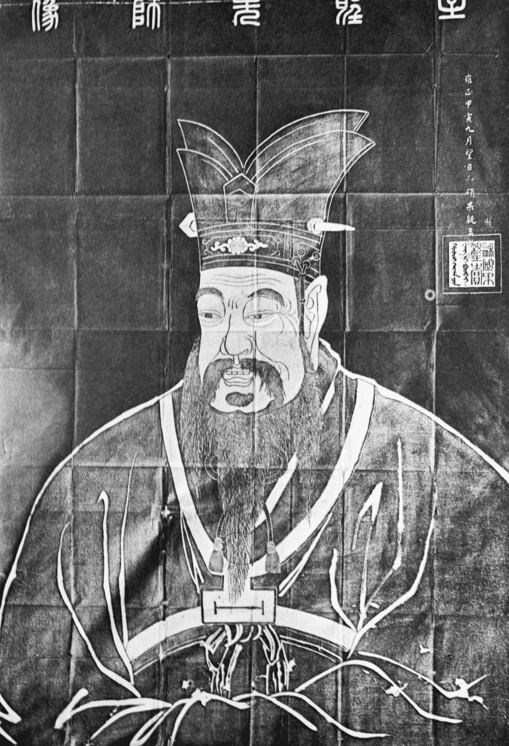
Bonus Activity!
Take the following saying from Confucius and re-write it in your own words. Then write a scenario where you think his wisdom might be useful!
Analects: …Confucius said: When you see a good man, think of becoming like him. When you see someone not so good, reflect on your own weak points.

Slide 22
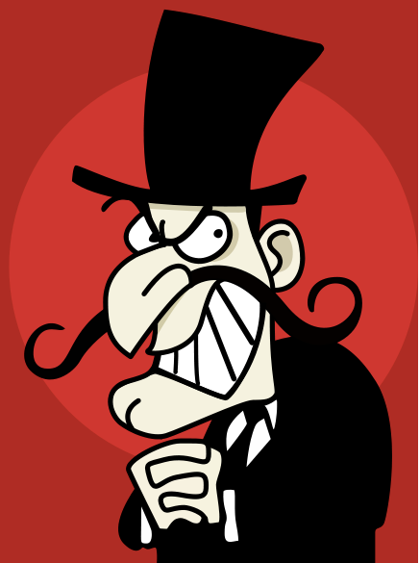
You are eating lunch with Baron Von Bumble. You know he never eats his vegetables and instead secretly hides them in his big black hat until he can throw them away.
Your mother always packs you a healthy apple in your lunch but you do not like fruit very much. The Baron tells you he wouldn’t tell anyone if you toss your apple in the garbage.
Remember this if you want to use it. It’s not in the lesson plan we’ll give you.

Slide 23
Common Core Standard-Literacy.RH.6-8.1: Cite specific textual evidence to support analysis of primary and secondary sources.
Common Core Standard-Literacy.RH.6-8.2: Determine the central ideas or information of a primary or secondary source; provide an accurate summary of the source distinct from prior knowledge or opinions.
Common Core Standard-Literacy.RH.6-8.4: Determine the meaning of words and phrases as they are used in a text, including vocabulary specific to domains related to history/social studies.

Slide 24
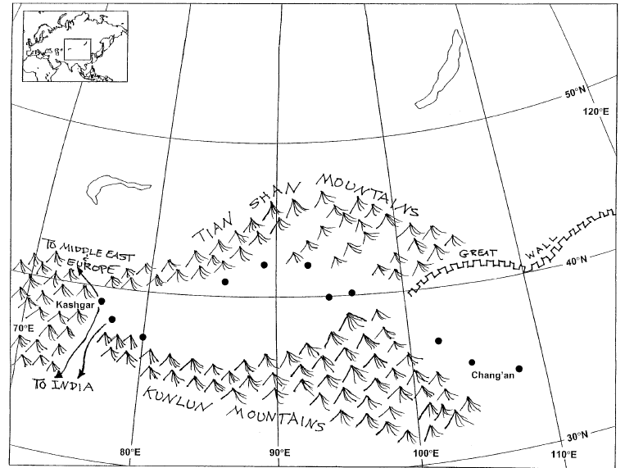
The Silk Road Challenge

Slide 26
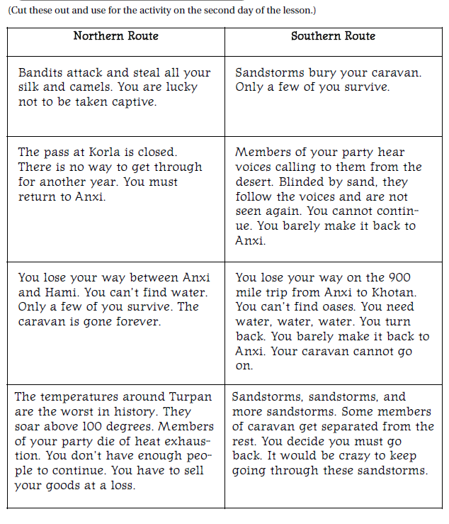

Slide 27
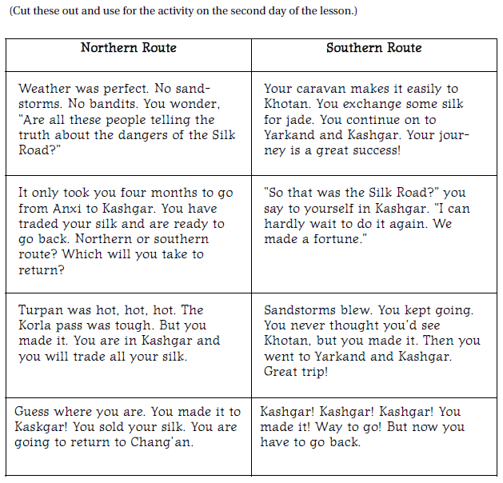

Slide 28
UPCOMING
FREE WEBINARS!
Register @ www.crf-usa.org/pd
Civic Engagement + Writing = Uncommonly Good Idea!
Tuesday, October 20, 3:30 p.m.–4:30 p.m. (PST)
You CAN Make Teaching From Primary Sources Exciting: Three Successful Strategies for Middle School and High School Teachers.
Thursday, October 22, 4:30 p.m.–5:30 p.m. (PST)

Slide 29
THANK YOU!
For support and information contact:
Keith@crf-usa.org
Keri@crf-usa.org
www.crfcap.org

